Slide 1



SMART INDIA HACKATHON 2025
Problem Statement ID – SIH25004
Problem Statement Title- Image based breed recognition for cattle and buffaloes of India
Theme- Agriculture,Foodtech & Rural Development (Government of India)
PS Category- Software
Team ID- 08
Team Name- The Debug Mafia

Slide 2
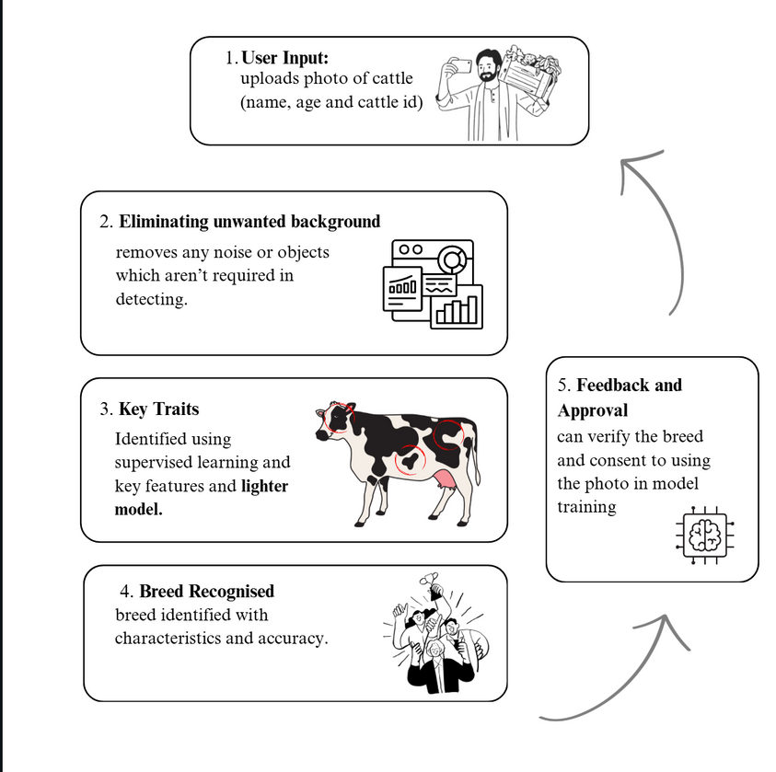
CALF - Classification & Analysis of Livestock using Features
THE
DEBUG
MAFIA
Proposed Solution
AI - Based App to detect the breed of cattle.
Farmers capture photo of cattle and upload to our app to know the breed.
Smooth and Simple to use UI.
Lightweight ML Models in detecting the breed with quicker results.
Built-in translation to ease readibilty.
Easy data collection through photos and to improve the model.
Notes:
null

Slide 3
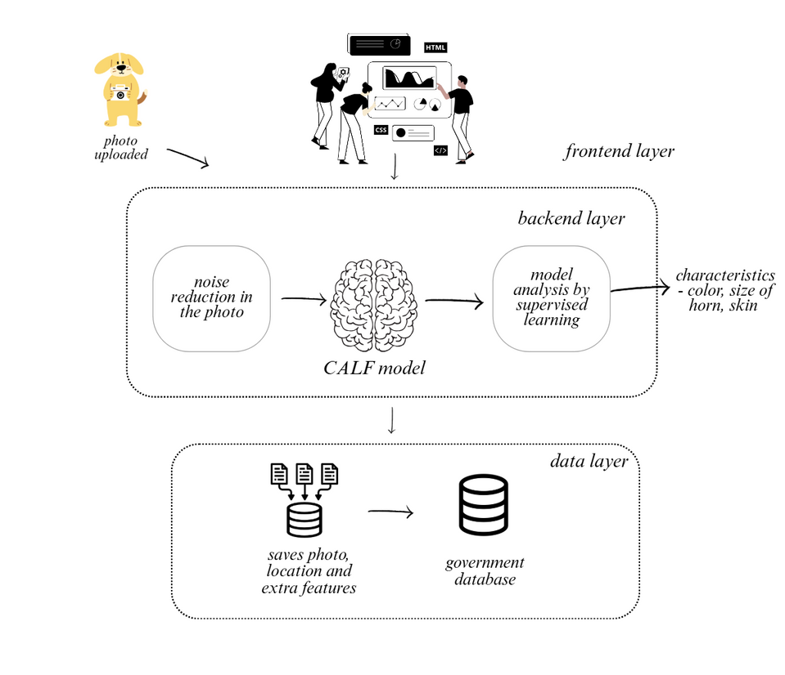
TECHNICAL APPROACH
THE
DEBUG
MAFIA
Technologies to be used
Methodology and process for implementation
Programming Languages: Python, HTML, CSS, Javascript, MongoDB.
User Input: farmer name, cattle name, cattle id (government registered ID).
Preprocessing: clear background noise.
CALF Model: Fast and Compact Model.
Result: breed identified, basic features about the breed.
Data Collection: collecting data based on consent.
Feedback: helps in improving the model.
Framework: TensorFlow, OpenCV, Flask, React, Next.js Supabase, Cloudinary.
Notes:
null

Slide 4
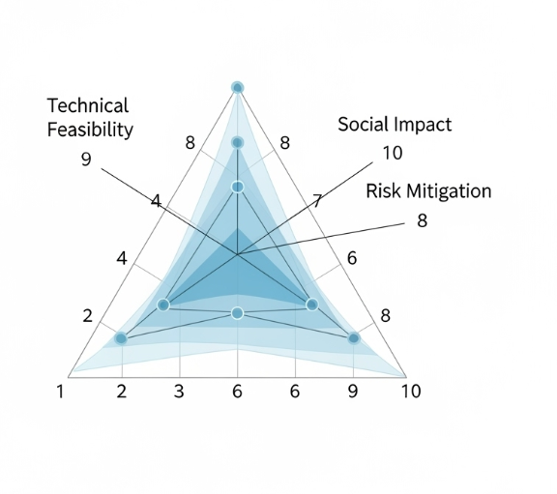
FEASIBILITY AND VIABILITY
THE
DEBUG
MAFIA
ANALYSIS OF THE FEASIBILITY OF THE IDEA
Low Cost and can be built with open sources.
Instant help to farmers in knowing the breed.
Helps in preserving indigenous breeds of India.
POTENTIAL CHALLENGES AND RISKS
Some areas are remote and lack network.
Collecting photos and labeling is time consuming.
Lack in trust with AI
STRATEGIES FOR OVERCOMING THESE CHALLENGES
Provide a model which works offline.
Work alongside with veterinarians and NGO’s.
Building awareness with demo’s in regional languages.
Notes:
null

Slide 5
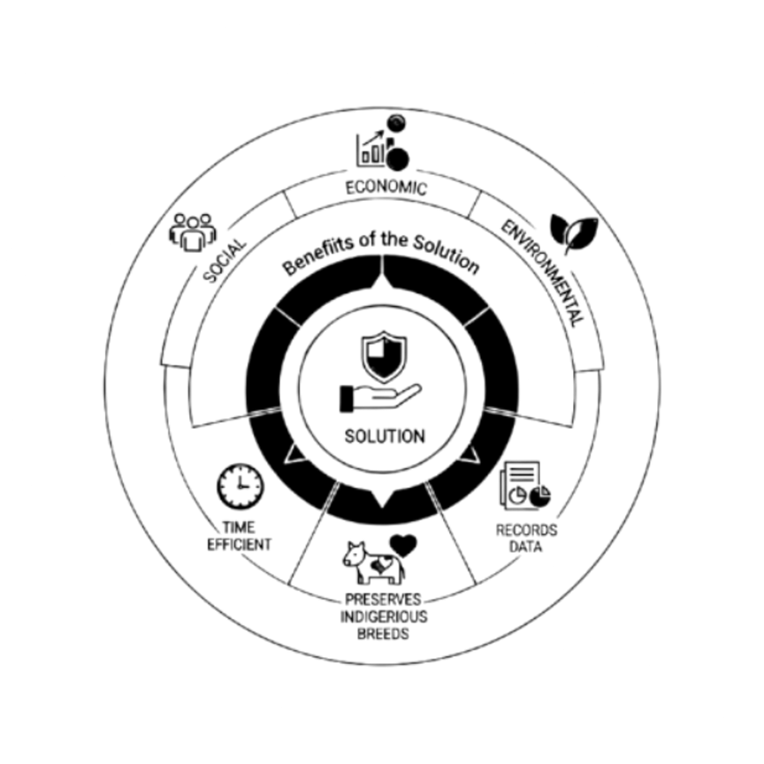
IMPACT AND BENEFITS
THE
DEBUG
MAFIA
POTENTIAL IMPACT ON TARGET AUDIENCE
Time Efficient
Helps preserve indigenous breeds.
Helps record data which can help in research and census report.
BENEFITS OF SOLUTION
Social: easily identifiable, improves knowledge, better breed management, easily accessible.
Economic: high productivity, reduces losses in mismatch, increases milk yield, promotes small scale retailers.
Environmental: protects indigenous breeds, reduces overuse of resources.
@SIH Idea submission- Template
Notes:
null

Slide 6

REFERENCES
THE
DEBUG
MAFIA
Indigenous dairy breeds of cattle and buffaloes - agritech.tnau
Computer Vision a computing framework for high-throughput in livestock operations - cvonedge
FedAAR: A Novel Federated Learning Framework for Animal Activity Recognition with Wearable Sensors - FedAAR
Cattle identification based on multiple feature decision layer fusion - Link
Classification of cattle breeds based on the random forest approach - Link
CattleFaceNet: A cattle face identification approach based on RetinaFace and ArcFace loss - Link
Notes:
null

